Slide 1



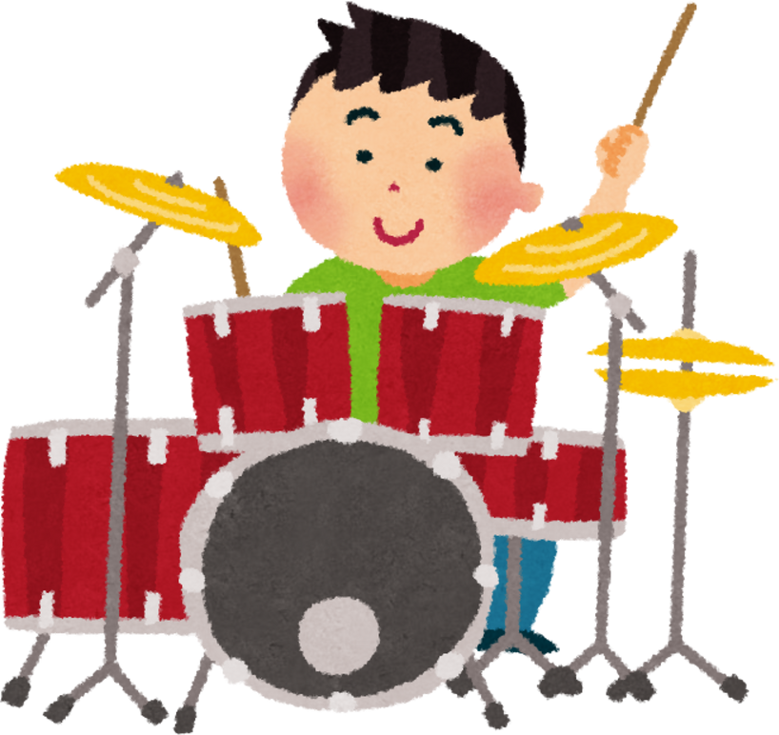
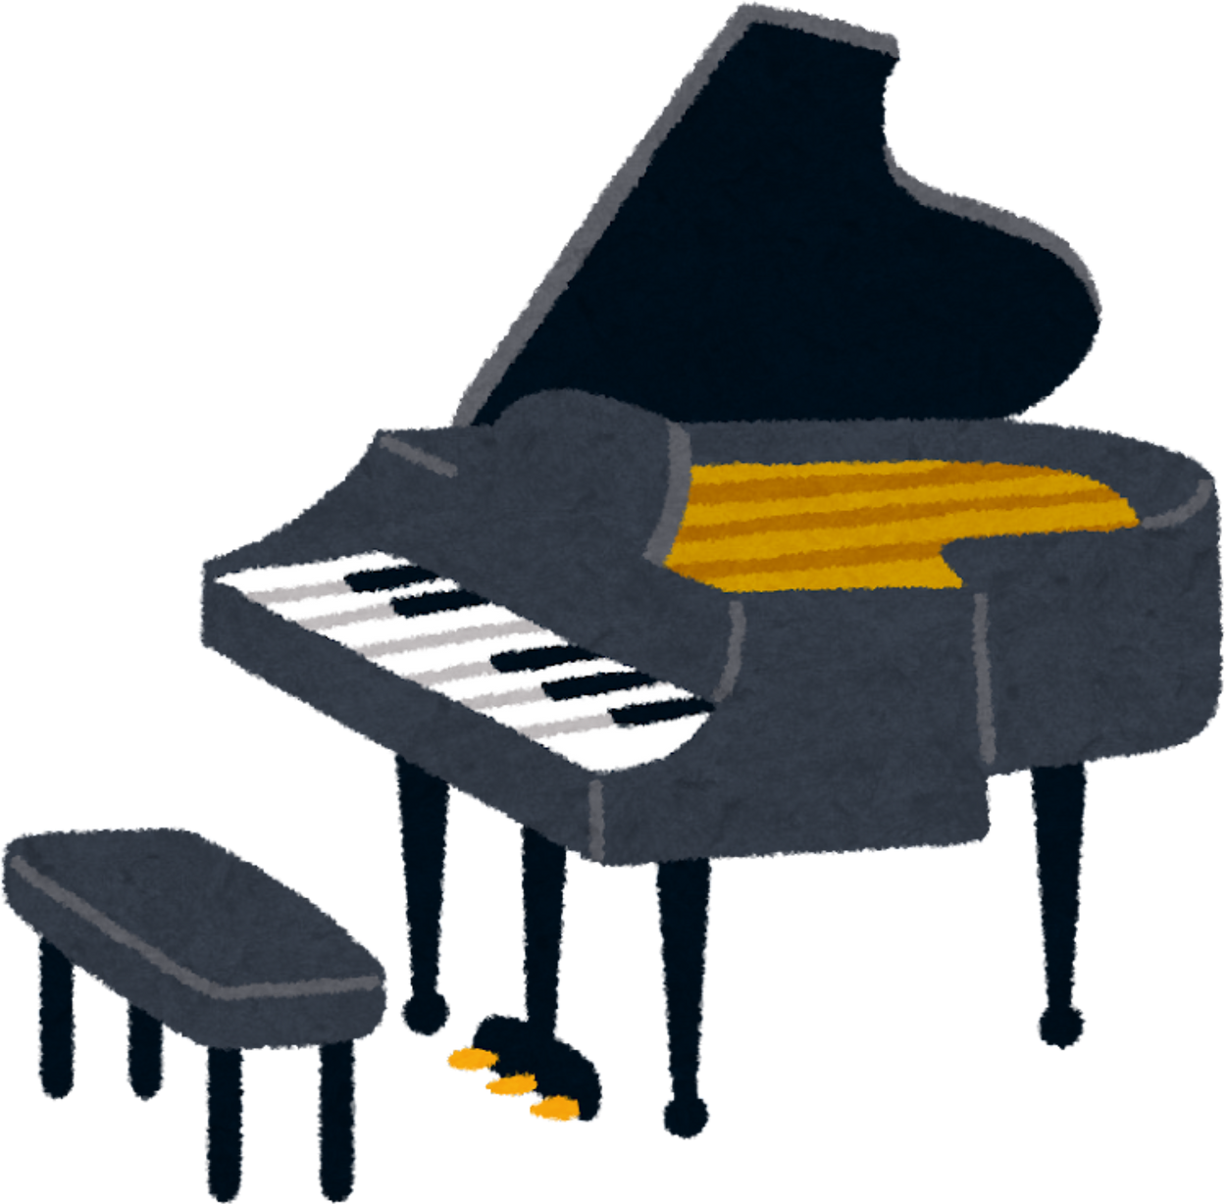
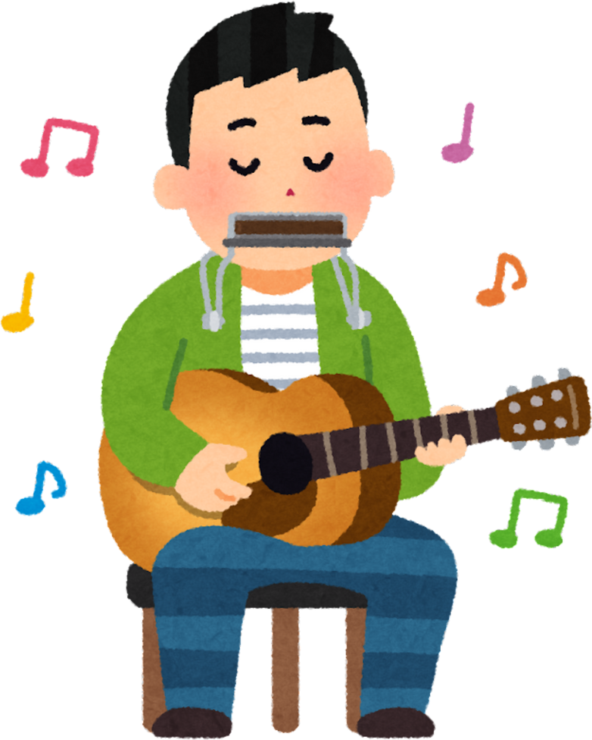
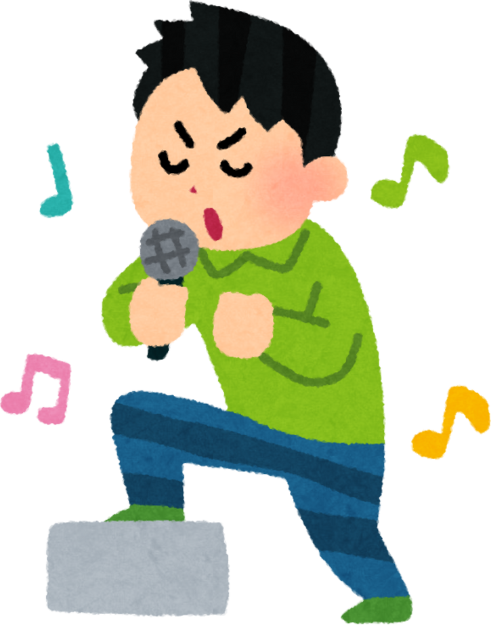


Percorso accademico abilitante di Formazione iniziale
60 CFA allegato 1
(DPCM 04/08/2023)
AJ56
PIANOFORTE SCUOLA SECONDARIA DI I GRADO
CANDIDATO: SALVATORE COSTANTINO
MATRICOLA: 13571

Slide 2
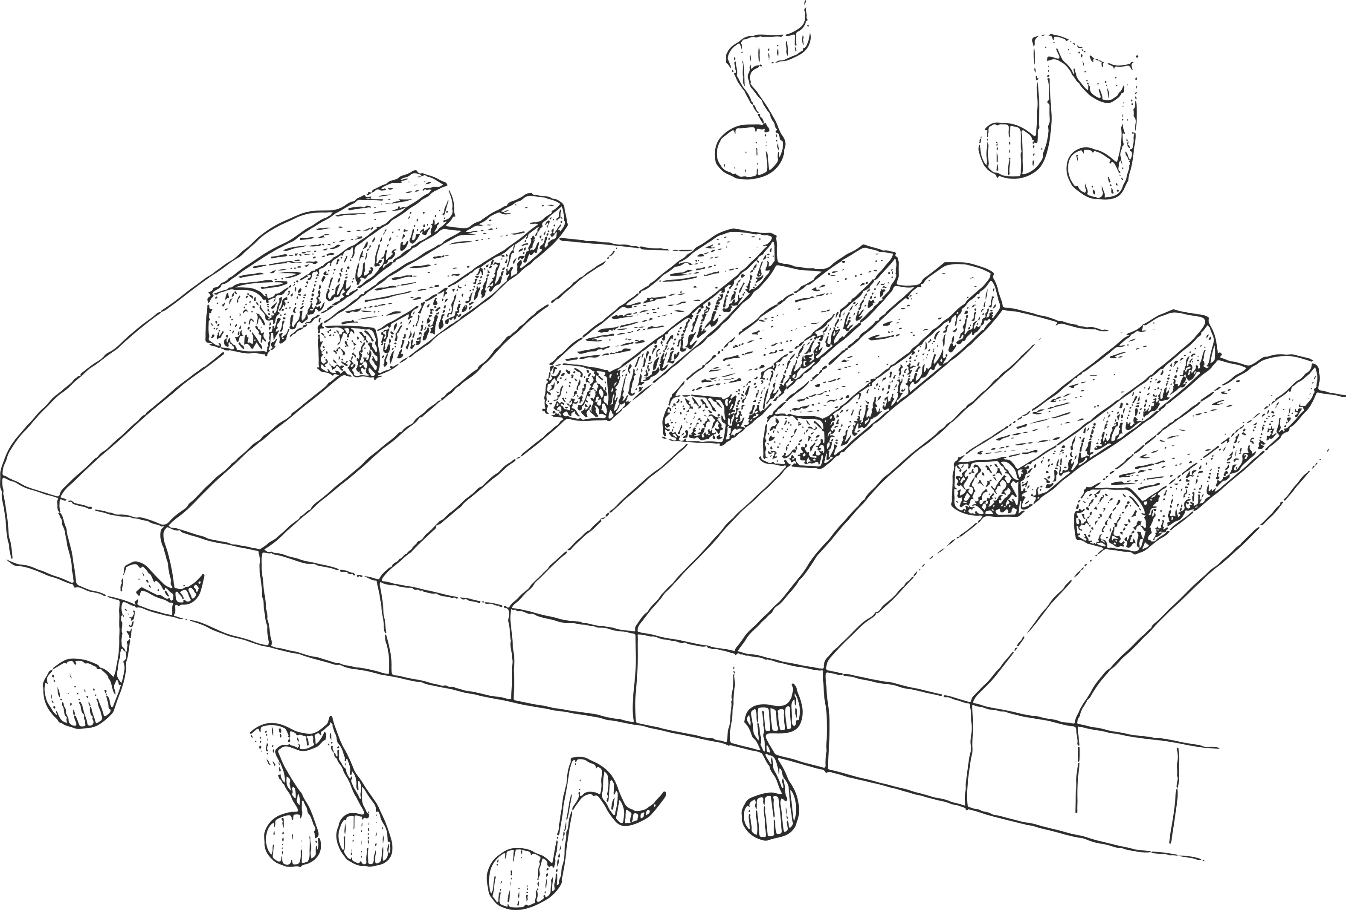
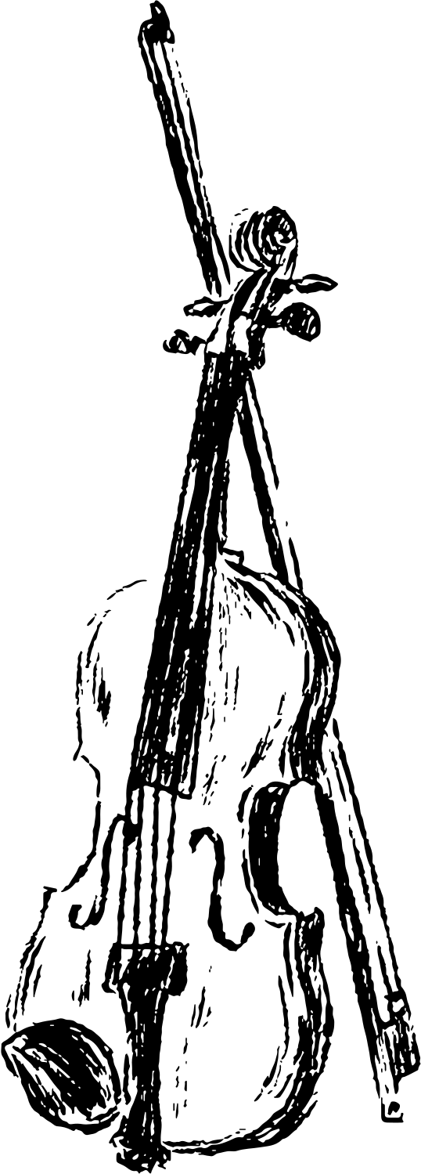
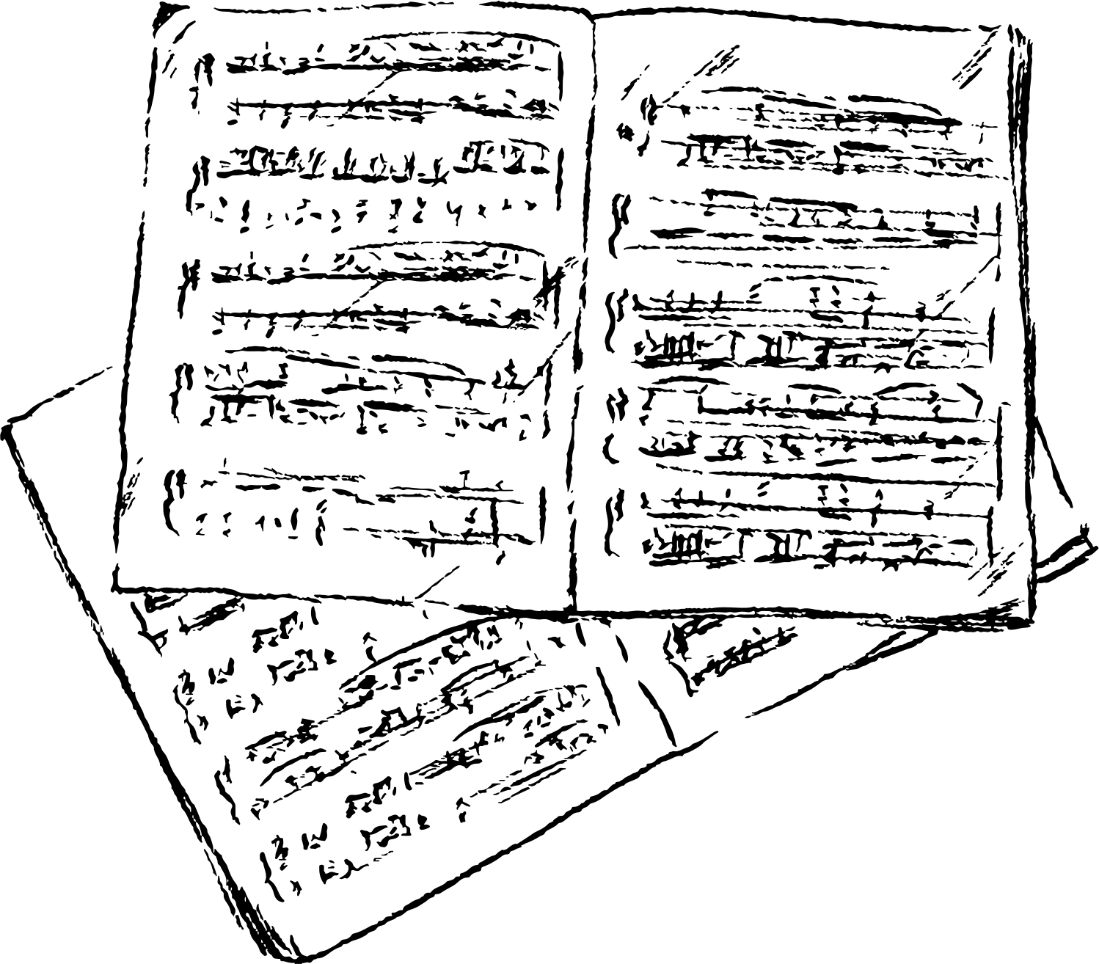
Titolo della lezione

Slide 3
CONTESTO E DESTINATARI
CLASSE
ALUNNI
BES
dfgdfgdfg
dfgdfgdfg
dfgdfgdfg

Slide 4
PREREQUISITI RICHIESTI
🎵Conoscenza della postura e tecnica pianistica di base
📖Capacità di lettura in chiave di violino e di basso
🪘Conoscenza delle figure ritmiche fondamentali
⏱️Capacità di sincronizzazione con il metronomo

Slide 5
OBIETTIVI FORMATIVI
CONOSCENZE
ABILITÀ
Similar to a piano but uses electricity to create different sounds.
Blowing air into the mouthpiece and pressing the keys allows air to pass through reeds, creating sound.
Competenze trasversali - Indicazioni Nazionali(DM 254/2012)
Indicazioni Nazionali e Nuovi Scenari" del 2018
(DM 254/2012)
Raccomandazione del Consiglio del 22 maggio 2018
relativa alle competenze chiave per l'apprendimento
Gazzetta ufficiale dell'Unione europea (C 189/1 del 4.6.2018)

Slide 6


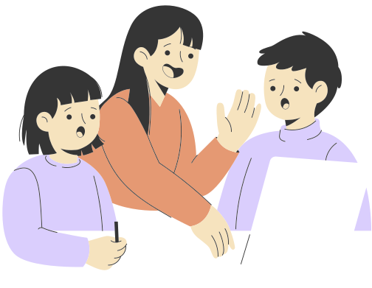
Metodologie didattiche
FLIPPED
CLASSROOM
COOPERATIVE LEARNING
PEER TO PEER

Slide 7
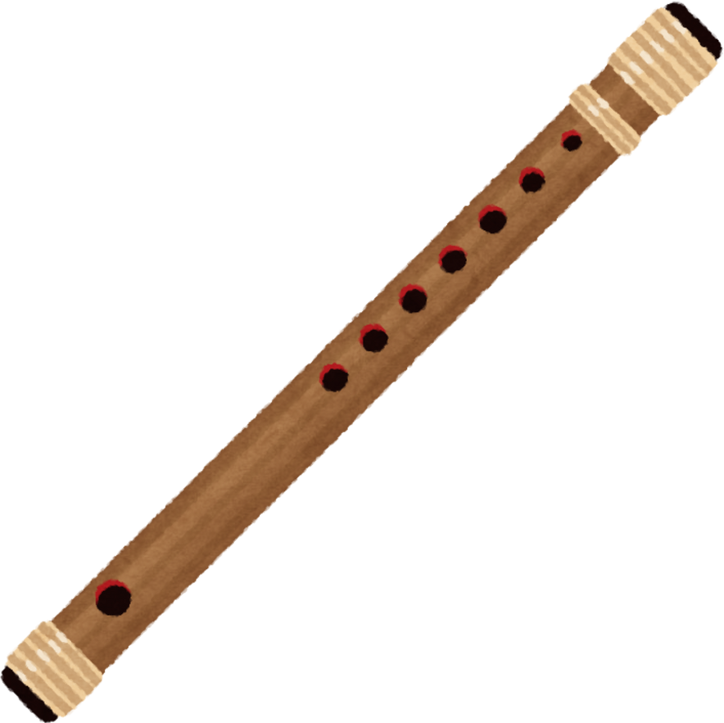
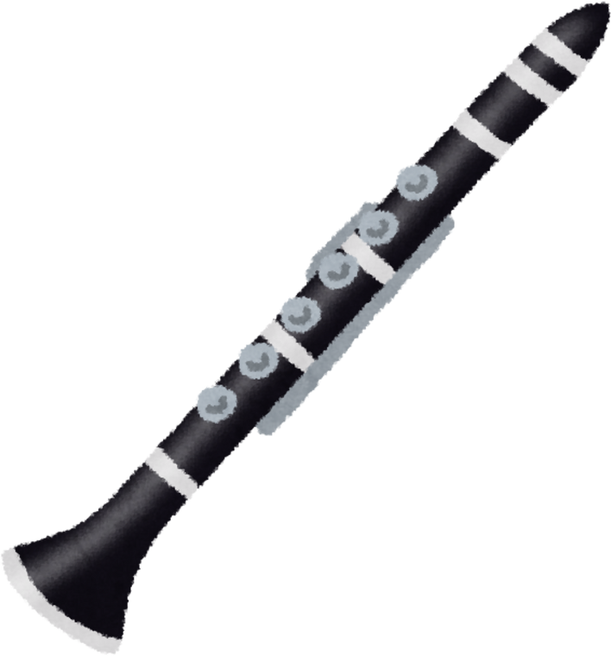
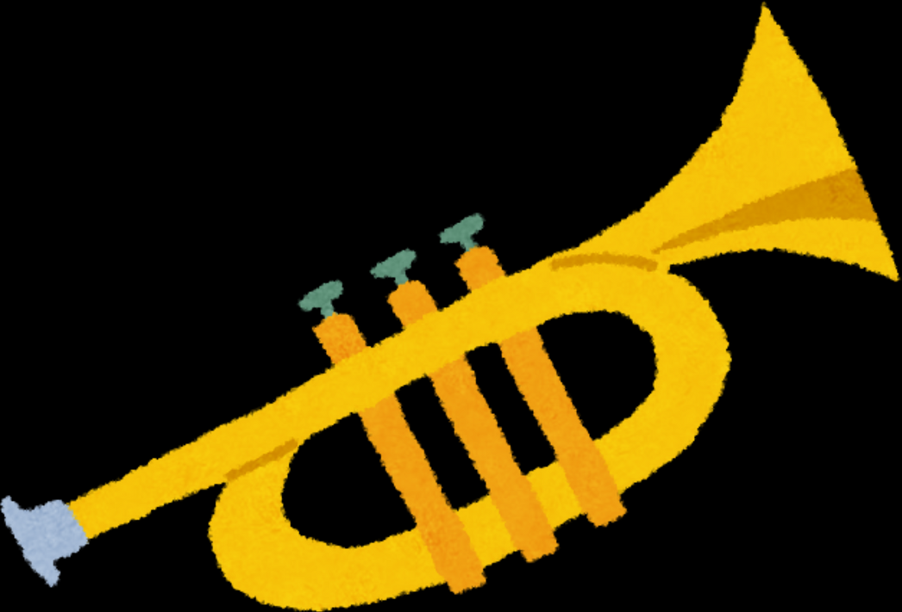
Titolo della lezione
Wind instruments produce sound by blowing air into them. The air vibrates inside the instrument, creating sound. You change the pitch by pressing keys or covering holes.
It is commonly found in orchestras, marching bands, and jazz ensembles.
Examples
Flute (You blow air into it to make music, and you use your fingers to cover holes to change the sound.)
Clarinet (It has a single reed that vibrates when you blow air into it.)
Trumpet (A brass instrument where you buzz your lips into a mouthpiece.)

Slide 8
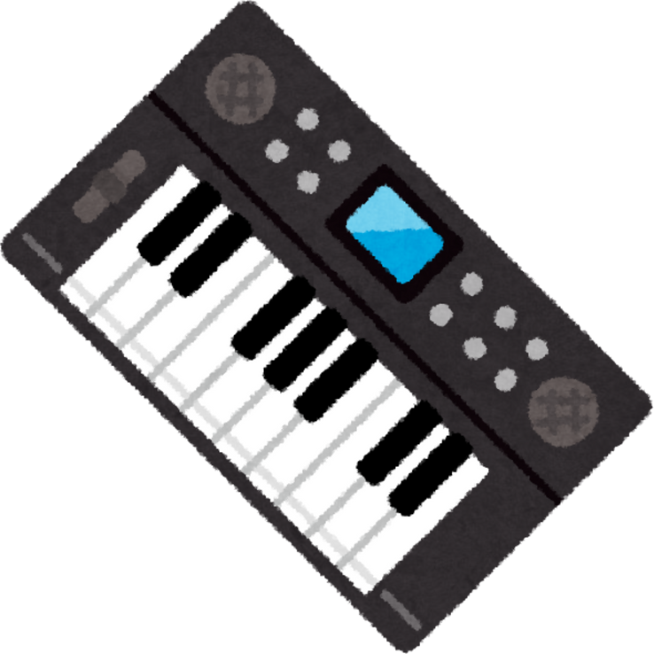
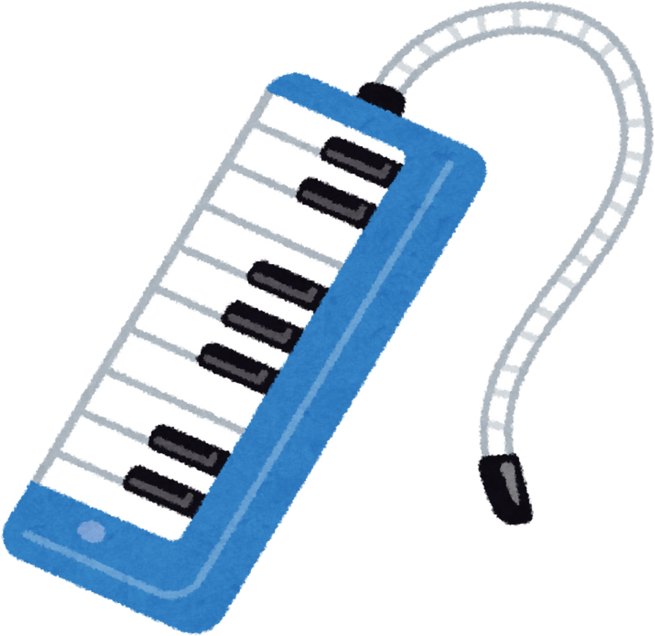
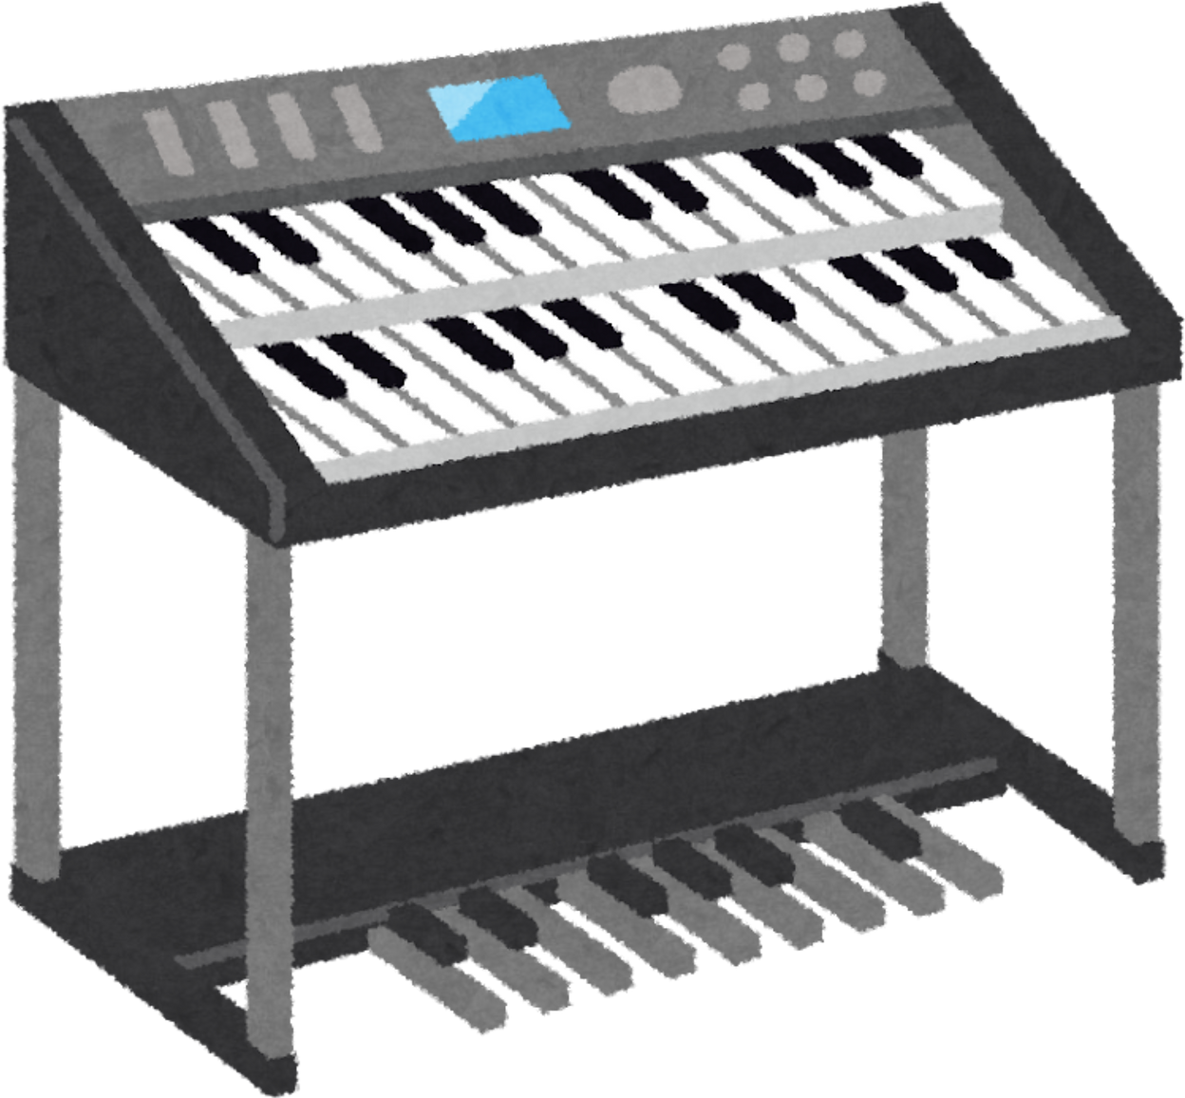
Keyboard Instruments
Keyboard instruments make sound when you press keys that trigger strings, pipes, or electronic sounds.
These instruments allow you to play both melody and harmony, making them very versatile.
Examples
Piano
Melodica
Keyboard

Slide 9

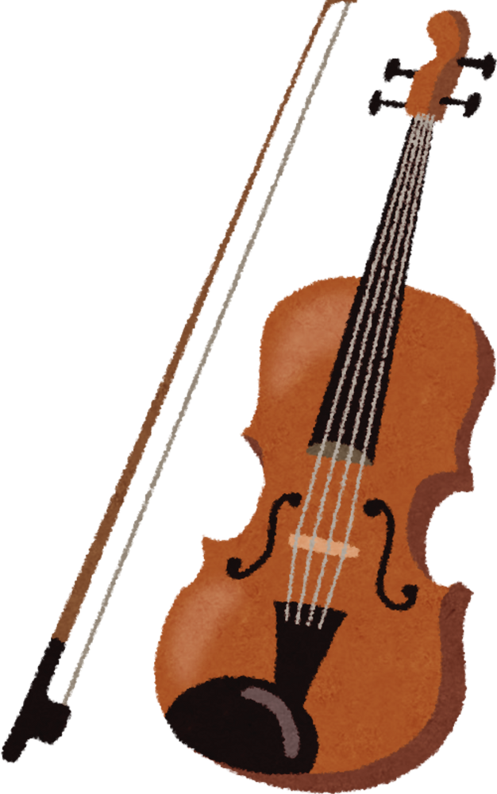
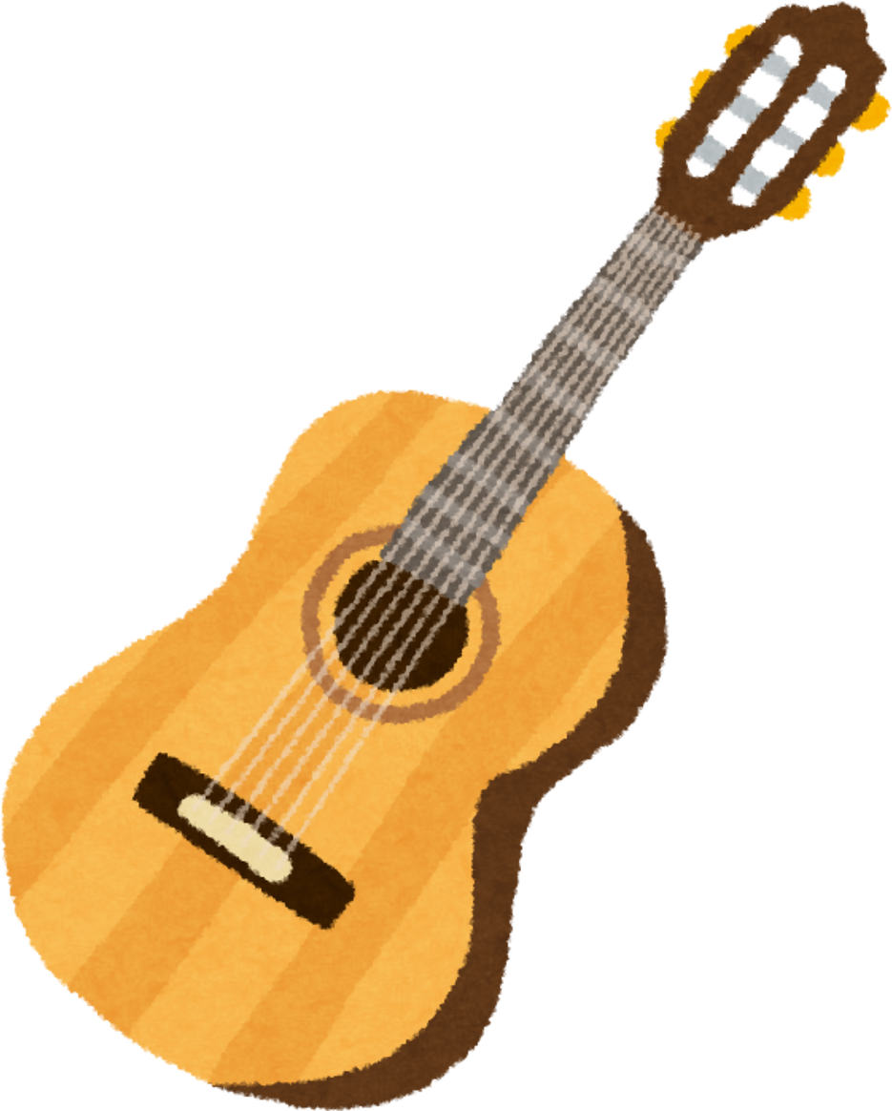
String Instruments
String instruments make sound by vibrating strings. You can pluck, strum, or use a bow to create these vibrations.
The length, thickness, and tension of the string change the pitch (how high or low the sound is).
Examples
Guitar (Played by strumming or plucking the strings.)
Violin (Played with a bow that glides across the strings.)
Harp (Played by plucking strings with fingers.)

Slide 10
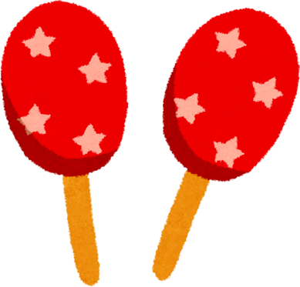
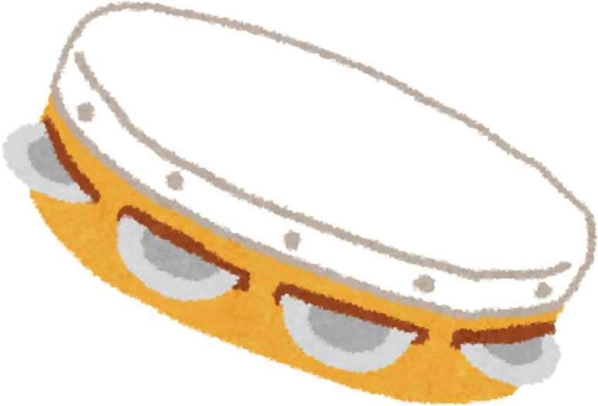
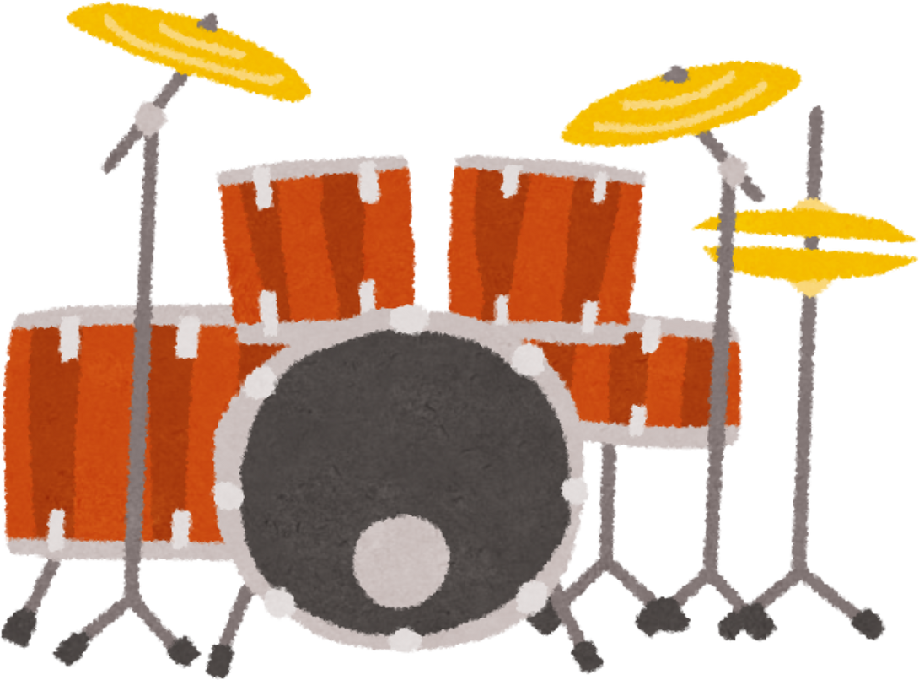
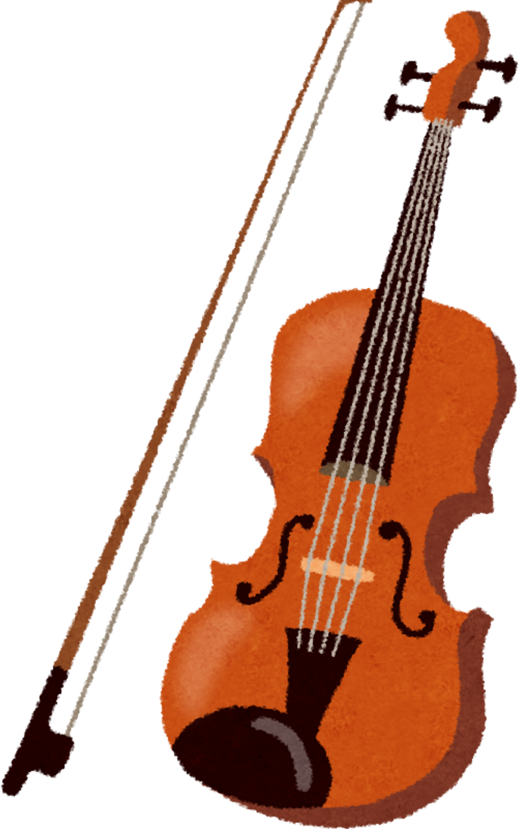
Resources Page

Slide 11
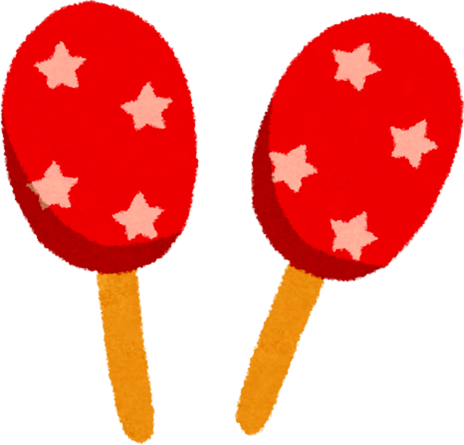
Percussion Instruments
Maracas
Drums
Tambourine
Shaken to make sound, as beads inside the instrument rattle.
A set of drums played with sticks or hands. Different-sized drums make different sounds.
A handheld drum with small metal discs that jingle when it is shaken or hit.

Slide 12

String Instruments
Violin
Guitar
Harp
Violin has four strings and is played with a bow.
Guitar has six strings that you can strum or pluck with your fingers.
Harp is a large instrument with many strings that you pluck with your fingers.

Slide 13
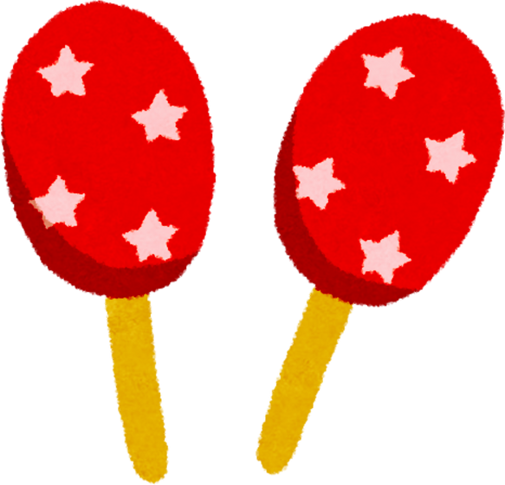
Percussion Instruments
Percussion instruments produce sound when you hit, shake, or scrape them. The vibration of the material creates the sound.
They are usually used to keep rhythm or add special effects to music.
Examples
Drums (You hit the drum with sticks or your hands to make a beat.)
Tambourine (A small round instrument with metal jingles, played by shaking or hitting.)
Maracas (A pair of instruments filled with beads or seeds, shaken to create sound.)

Slide 14
String Instruments
String instruments make sound by vibrating strings. You can pluck, strum, or use a bow to create these vibrations.
The length, thickness, and tension of the string change the pitch (how high or low the sound is).
Examples
Guitar (Played by strumming or plucking the strings.)
Violin (Played with a bow that glides across the strings.)
Harp (Played by plucking strings with fingers.)

